Slide 1
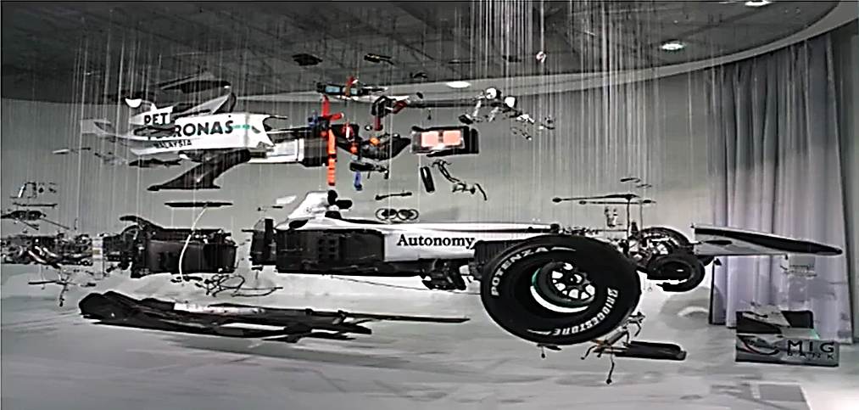
Automotive components

Slide 2
Suspension System
The suspension system has the following primary tasks to perform in a vehicle:
Provide safety and comfort to the driver and passengers
Uphold the structural integrity of the vehicle by dissipating forces arising from the ground
Make sure that the vehicle does not undergo dangerous
dynamic conditions such as roll over, toppling, side
slipping, etc.

Slide 3
Suspension System
The major components of the suspension system are the
following:
Spring damper system (shock absorber)
Control arms
Wheel Assembly
Wheels
Other miscellaneous components aiding the suspension system

Slide 4
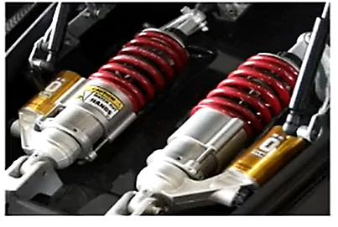
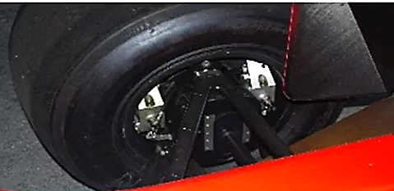
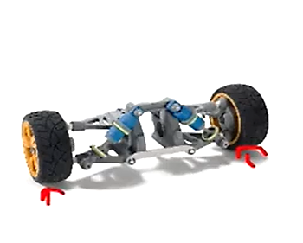
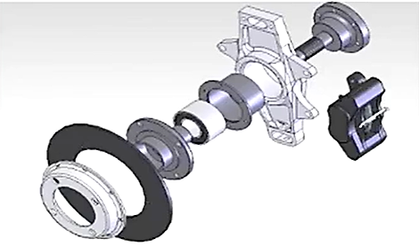
Suspension System

Slide 5
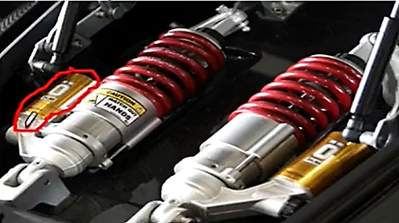
Suspension System
Spring Damper System
Consists of:
A spring element
A damping element
Spring element:
Provides Stiffness and passive force proportional to the displacement of the element: F=Kx (K=Spring constant,x= displacement of the spring)
Damping Element:
Provides damping in the system and passive force proportional to the velocity of motion of the element:
F=Cv(C=damping coefficient, v=velocity of damper)

Slide 6
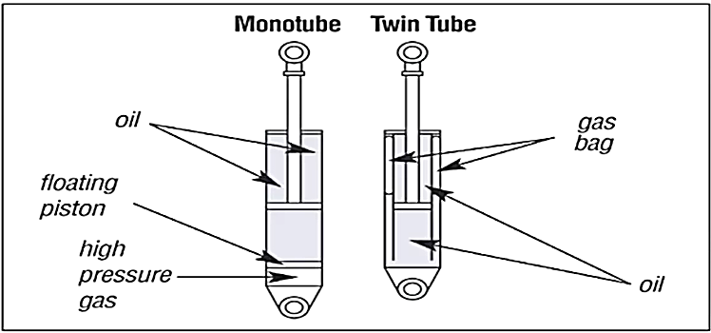
Suspension system
Spring Damper System
Are of mainly two types:
Monotube Suspension Systems
TwinTube Suspension Systems
Consists of:
Valves
Oil and oil reservoirs
Gas bags or gas reservoirs
Oil can also be replaced with high density gases

Slide 7
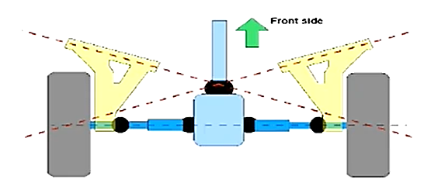
Suspension System
Suspension Control Arms
Consists of:
Rigid members
Joints with one or more degrees of freedom at both ends
Suspension control arms can be of different shapes and
sizes depending on the type of suspension.

Slide 8
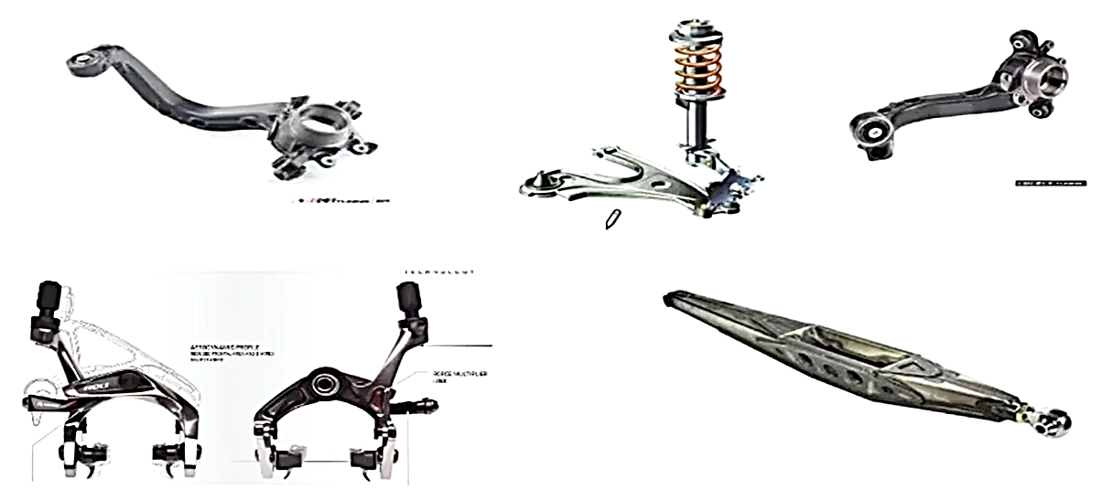
Suspension System
Suspension Control Arms

Slide 9
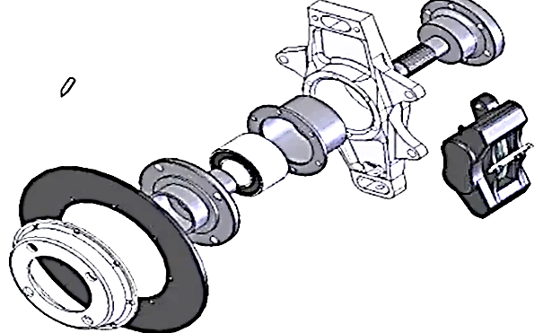
Suspension System
Wheel Assembly:
Consists of:
1. Hub
2. Brake Setup
3. Upright
Consists of:
Bearings
Spindle
Rim
wheel
The wheel assembly includes all the components which connect the Suspension arms to the wheel along with the wheel and the rim itself.

Slide 10
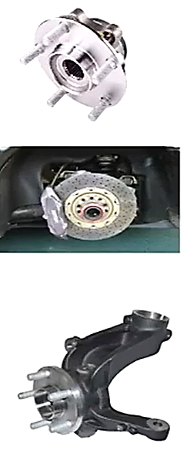
Suspension System
Wheel Assembly:
Hub:
This part is rigidly attached with the wheel and rotates along with it. The disc of the disc brake setup is also attached to it.
Upright:
This part is attached to the wheel through a ball bearing and thus does not rotate with the wheel. The brake calipers of the
brake setup are attached to it. Also, the suspension control arms are attached to the uprights through flexible joints.

Slide 11
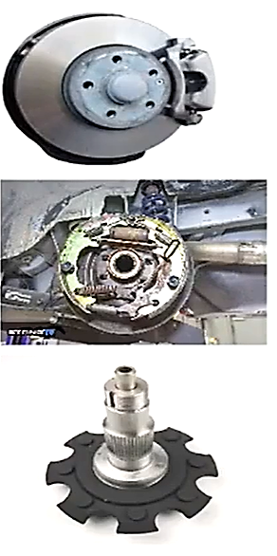
Suspension System
Wheel Assembly:
Brake Setup:
The brake setup components depend on the type of brake being used. The major types are disc brakes and drum brakes. The rotating parts of the brake setups are directly or indirectly attached to the hub while the non-
rotating parts are directly or indirectly attached to the upright
Spindle:
The spindle is the joining element which basically keeps all the elements of the wheel assembly together by acting as the axial element of connection. The non- rotating parts are attached to the spindle through ball
bearings while the rotating parts are attached through a key or splines.

Slide 12
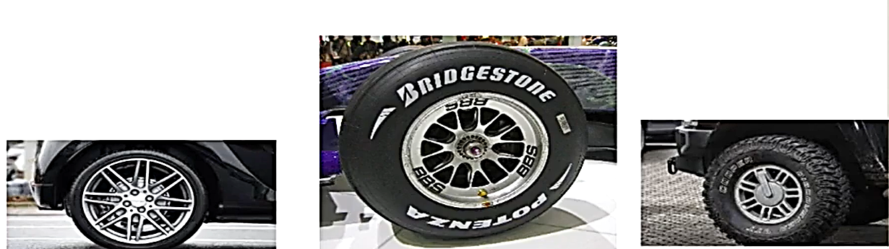
Suspension System
Wheels :
Wheels transfer the torque from the power unit of the automobile to the ground to propel it forward. However, the also play another important role of suspension as the tires also have some amount of stiffness and damping which should be taken into
account when designing and working with the suspension system of the vehicle.

Slide 13
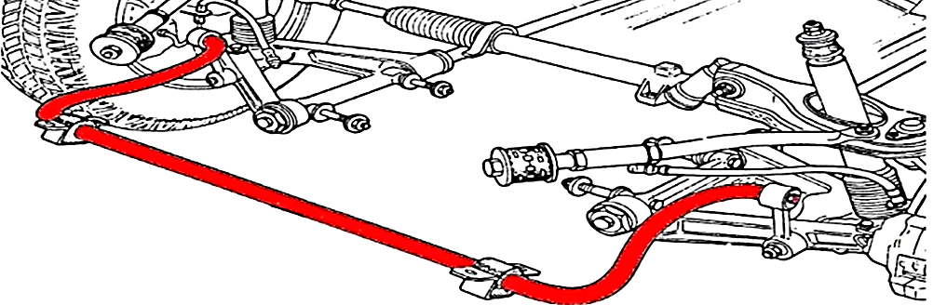
Suspension System
Miscellaneous components:
Anti-Roll bars:
An anti roll bar is specifically used to control the rolling motion of the vehicle. The anti roll bars are attached to the bottom arms of the suspension system and undergo a twisting torsional moment when the vehicle undergoes a rolling
motion.

Slide 14
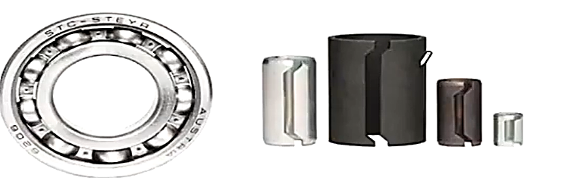
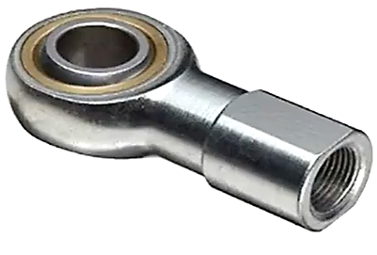
Suspension System
Miscellaneous components:
Bushings, bearings and rod ends
These are the components which help in the compliant motion of the
suspension system and its parts.
Bearings provide the necessary rotational motion.
Bushings provide the necessary flexibility and stiffness.
Rod ends provide the necessary degree of motions

